Slide 1

Human Speech Emotion Recognition
Group 2
MD. Akib Iqbal Majumder
ID : 18201142
Irfana Arafin
ID : 20201224
Tajish Farhan
ID: 18101312
Nusrat Jaman Pretty
ID : 18101582
Md.Abdullah Al Masum Anas
ID : 20141046

Slide 2
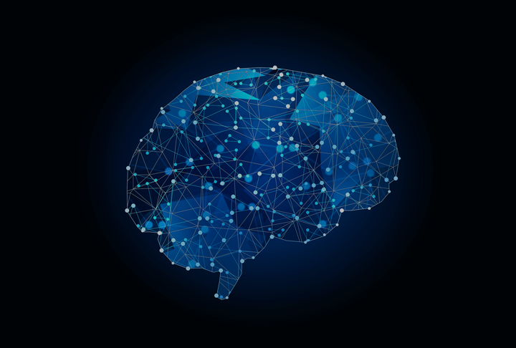
INTRODUCTION
Human Speech Emotion Recognition is known to be the procedure of identifying emotion from the natural speech.
Learning this process can enhance the human-machine communication experience.
Goal is to o improve the state-of-the-art performance
Four types of dataset to be worked upon. Ex: RAVDESS Emotional speech audio, Dataset CREMA-D, Surrey Audio-Visual Expressed Emotion (SAVEE),Toronto emotional speech set (TESS) dataset

Slide 3

Literature review
IMPROVING CHILDREN SPEECH RECOGNITION THROUGH FEATURE LEARNING FROM RAW SPEECH SIGNAL:
ASR is the main topic of this paper.
PF-STAR dataset is used for experimenting on children speech and WSJCAM0 is used for adult speech.
CNN , GMMHMM systems, DNN-HMM systems are utilized.
Lastly, SGMM systems is also used from multipass decoding and data scarcity to produce accurate results.

Slide 4
Literature review
Human speech emotion recognition:
PRNN and K-NN system, and a hybrid MFCC and GLCM system were used
A hybrid MFCC and GLCM system were each used in turn to each of these three phases.
A hybrid system combining MFCC and GLCM was developed as a result of GLCM’s increased use of the spectrogram of sound generated by MFCC to create a superior grayscale matrix for classification.

Slide 5

Datasets
One is RAVDESS Emotional speech audio that consists of 1440 files with randomized datas of speech collected from songs, audios and videos.
Dataset CREMA-D focused more on accents and pronunciation by choosing actors of different ethnicity.
Toronto emotional speech set (TESS) dataset has a collection of 2800 datas.
Surrey Audio-Visual Expressed Emotion (SAVEE) dataset was recorded from four native English male speakers.

Slide 6
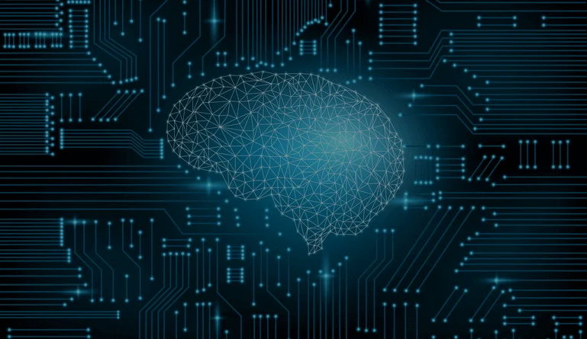
Data Pre-processing & Data Augmentation
As we are working with four different datasets, so we will be creating a dataframe storing all emotions of the data in dataframe with their paths.
We will use this dataframe to extract features for our model training.
We can construct syntactic data for audio by injecting noise, altering time and modifying pitch.
For our datasets we have used noise , stretched, shifted and pitch for data augmentation.

Slide 7

Feature Extraction & The Model
Feature Extraction:
Extraction of features is a very important part in analyzing and finding relations between different things. As we already know that the data provided of audio cannot be understood by the models directly so we need to convert them into an understandable format for which feature extraction is used. We have used :
Zero Crossing Rate
MFCC
RMS
Our model has 6 1D convolutional layers.

Slide 8
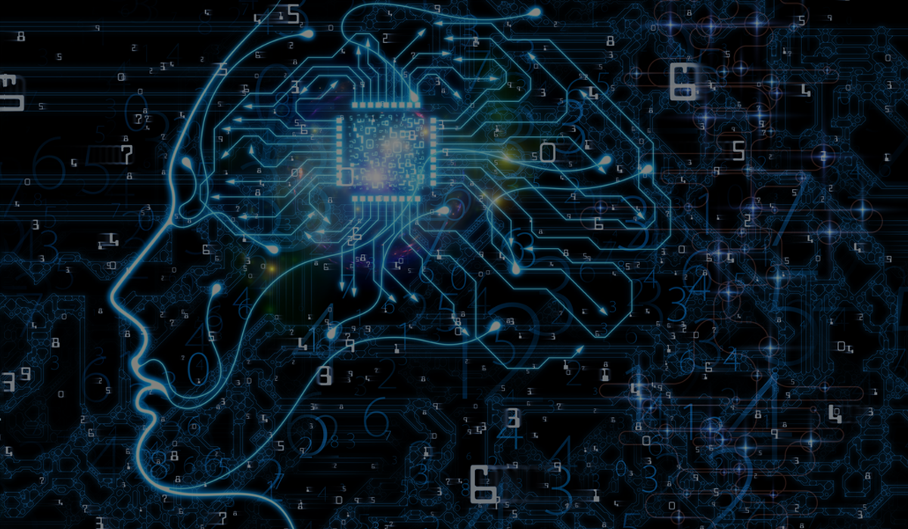
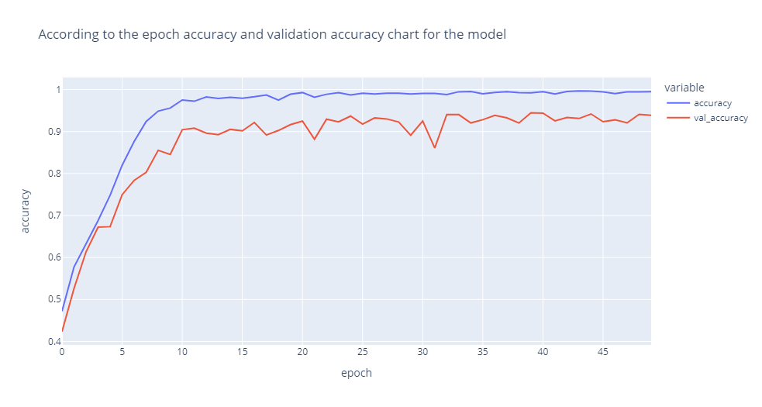
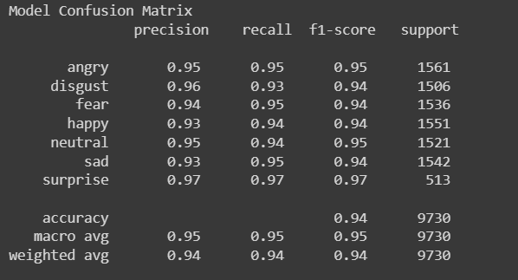
Training CNN model and Results
The model was trained over 50 epocohs.

Slide 9

Conclusion and Future Work
Extract speaker’s emotional state from voice
Higher precision and reduced complexity(CNN architecture)
Combined Four different datasets
Employ federated learning in the future
Elevate precision and accuracy combining compatible models

